Slide 1
Calibration Data Analysis

Slide 2
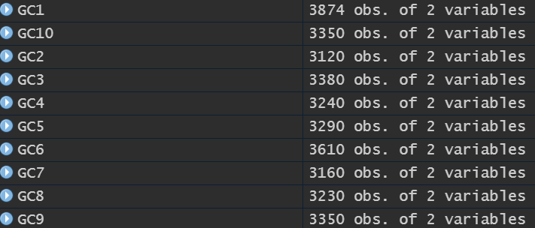
Deming observations

Slide 3
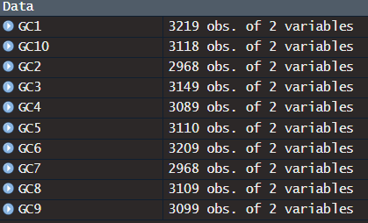
LC observations

Slide 4
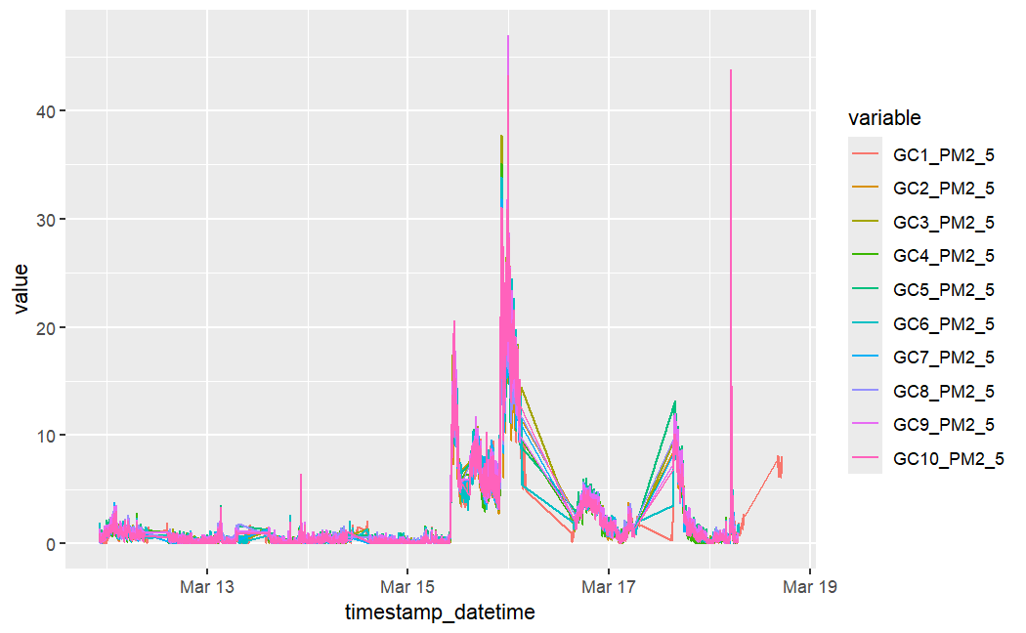
Deming calibration

Slide 5
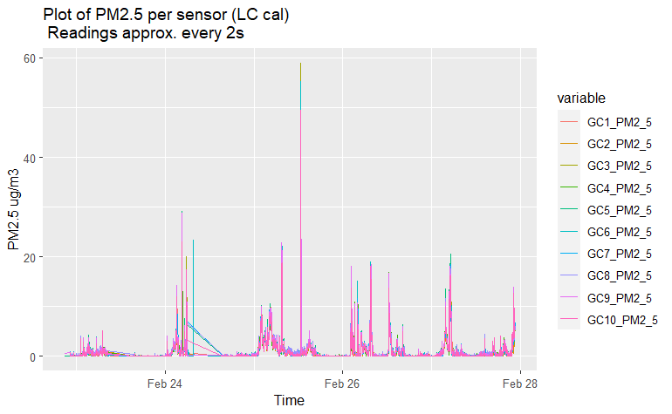

Slide 6
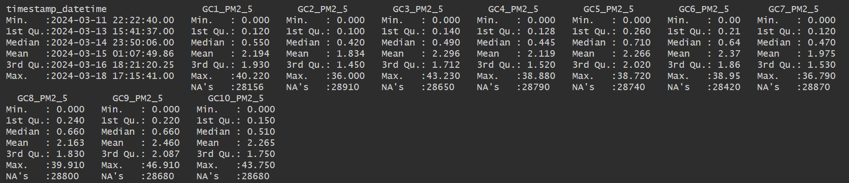
Deming calibration data summary

Slide 7
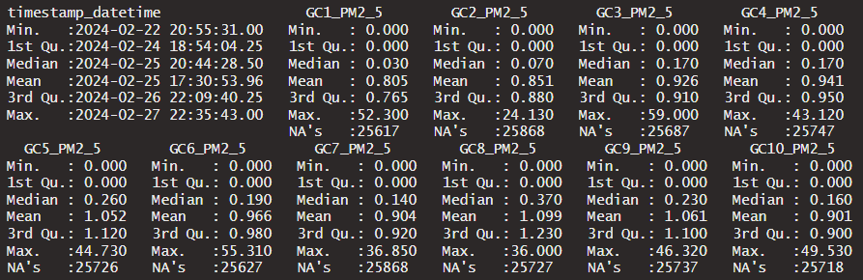
LC calibration data summary

Slide 8
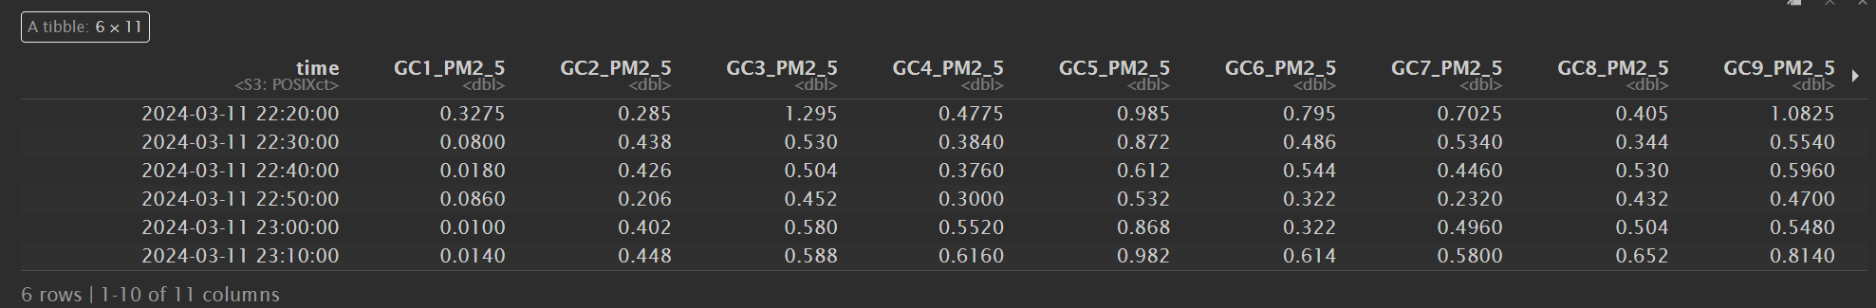
Deming 10-average readings example

Slide 9
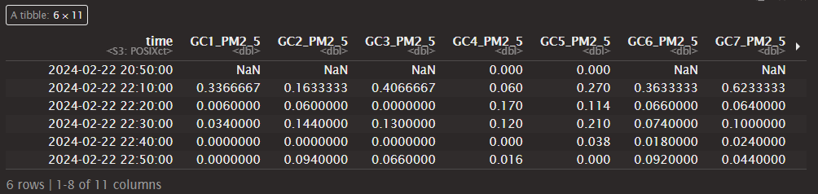
LC 10-average readings example

Slide 10
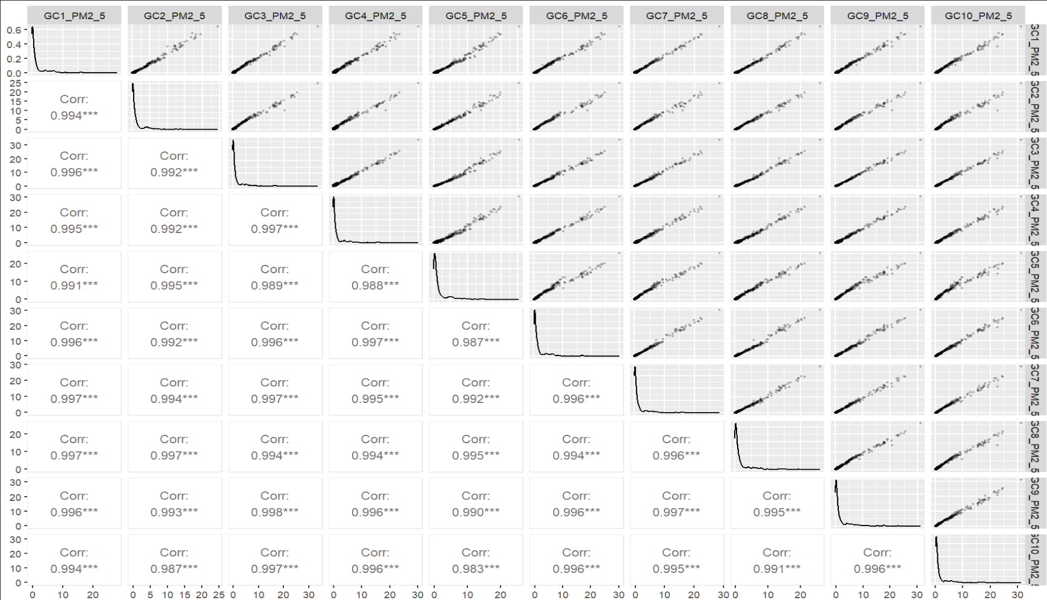
Deming correlations

Slide 11
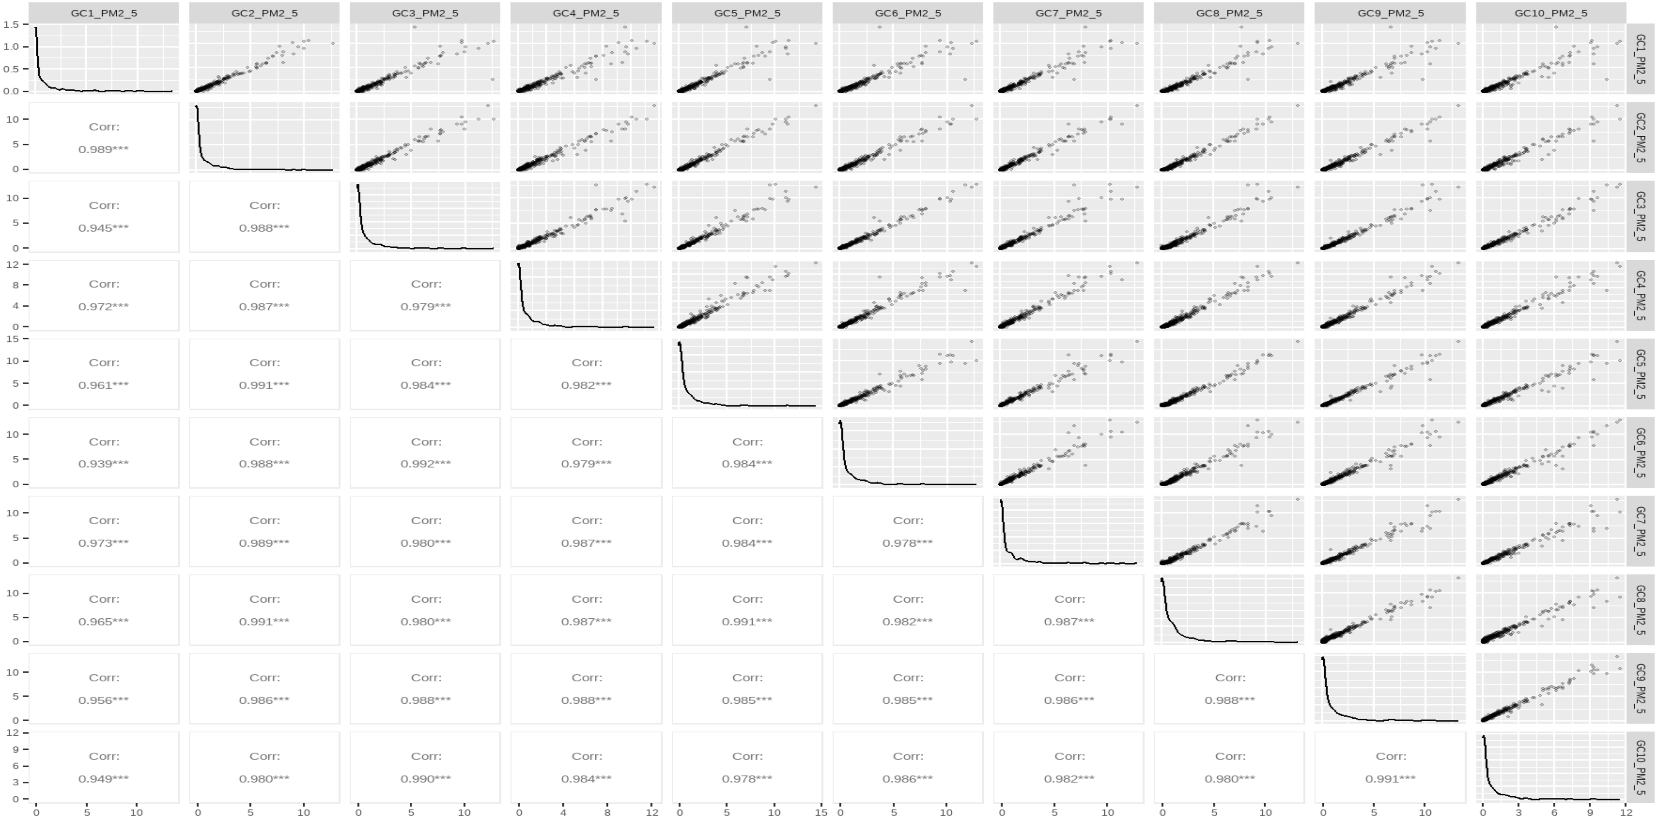
LC correlations

Slide 12
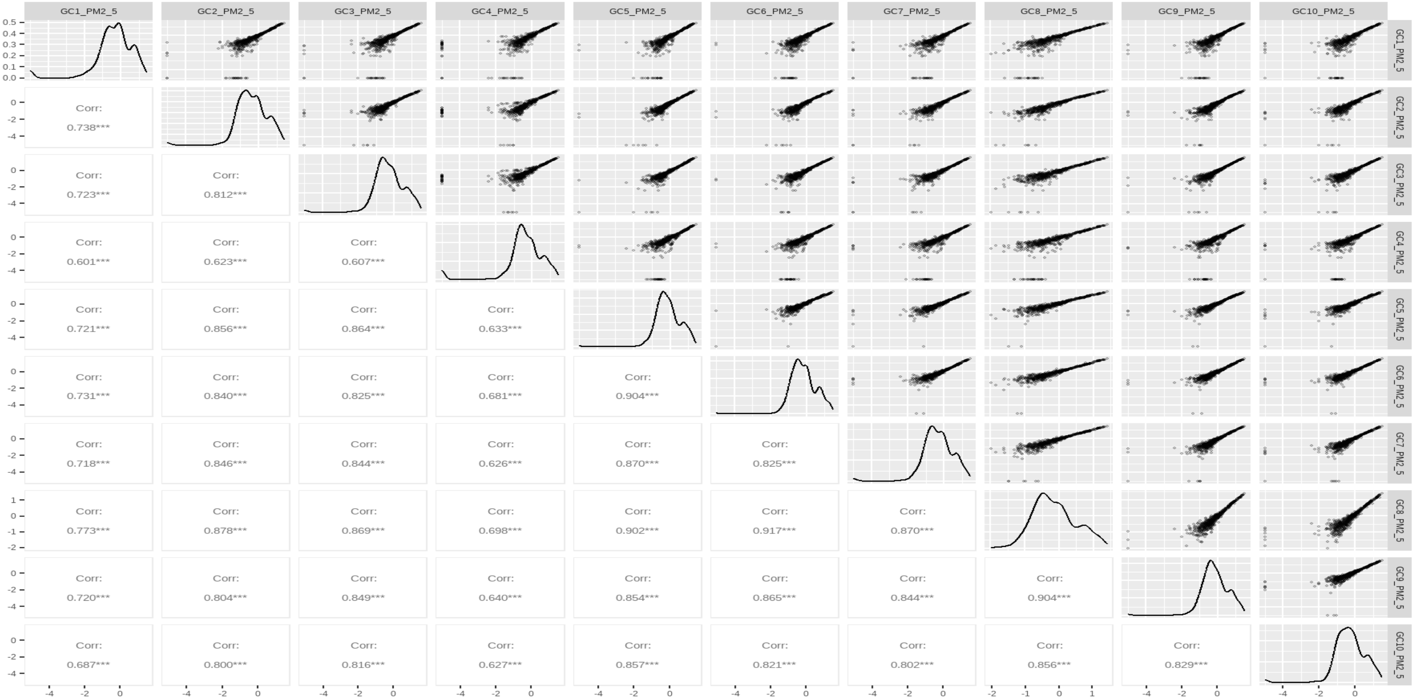
Deming correlations log transformed

Slide 13
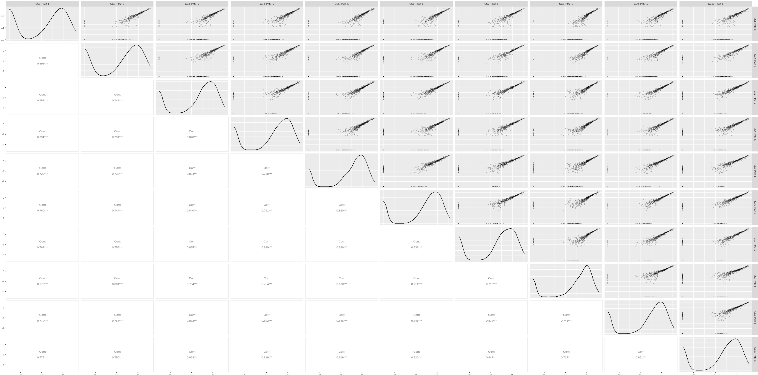
LC correlations log transformed

Slide 14
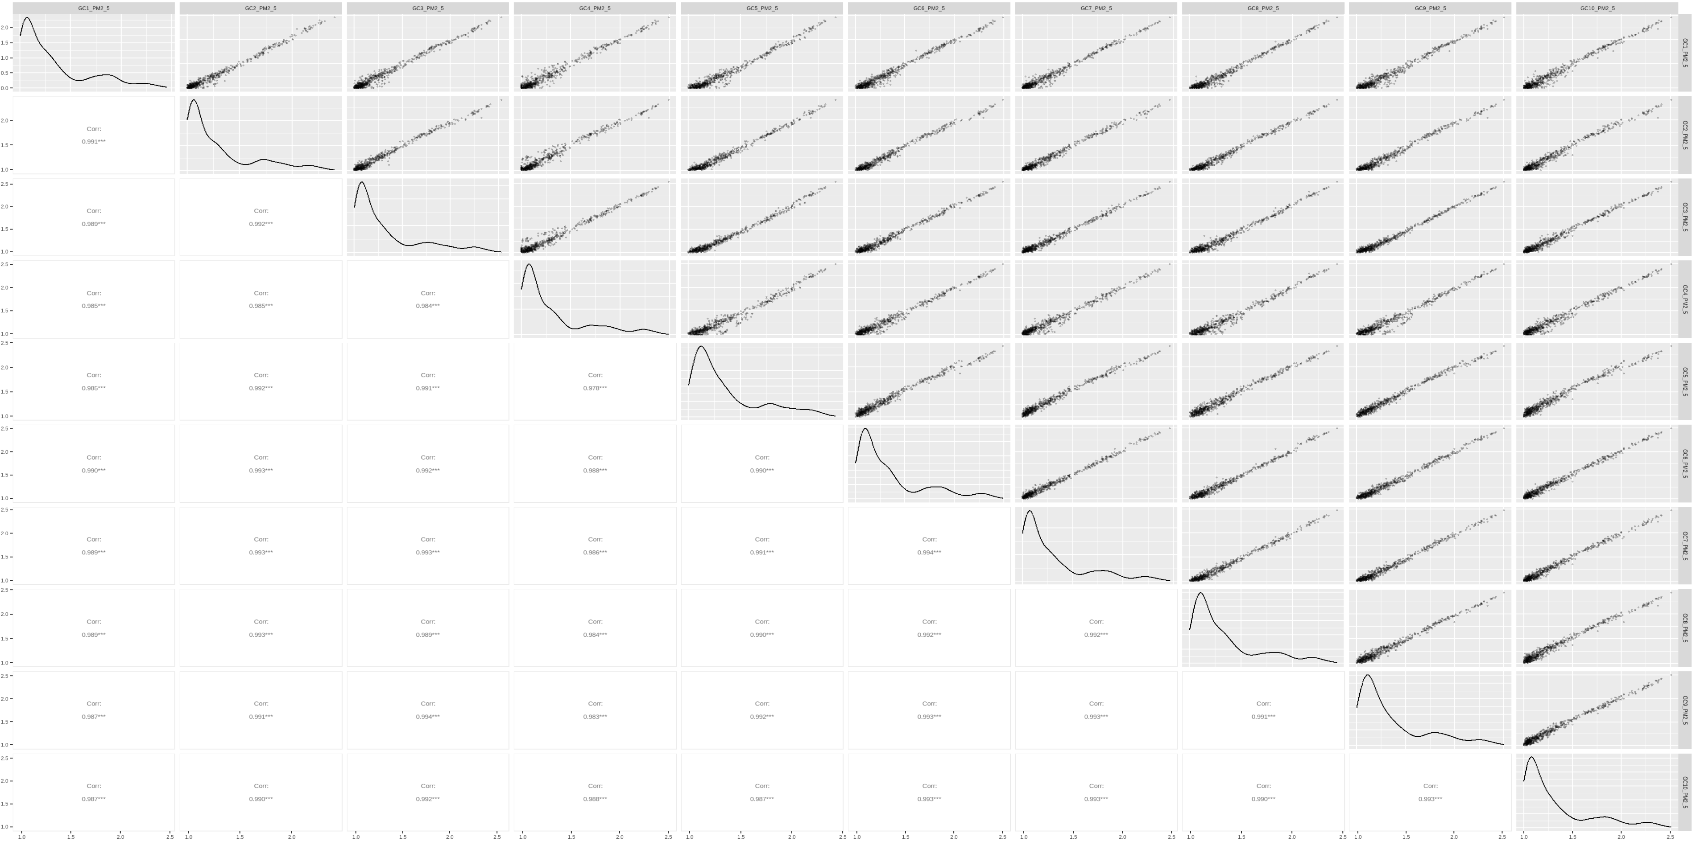
Deming correlations log transformed (all positive)

Slide 15
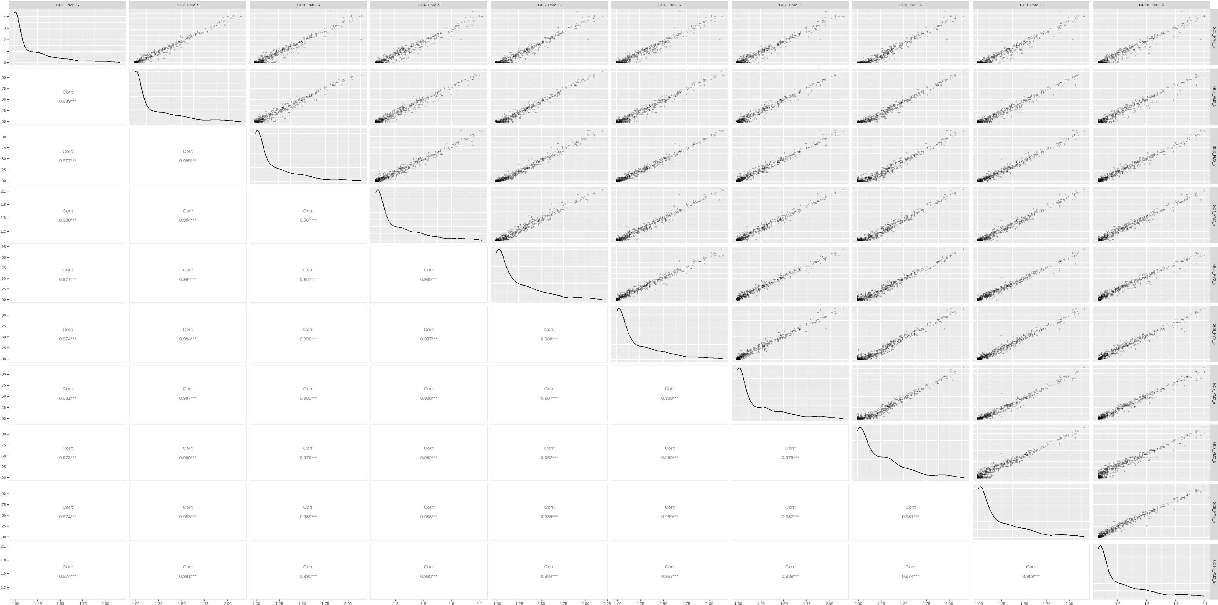
LC correlations log transformed (all positive)

Slide 16
Summary
Generally strong agreement between sensors
Variance is greatest at very low PM concentrations <1 ug/m3, and during quick large spikes
PurpleAir is most informative for relative magnitude of PM across space, not precise PM concentration
SD card is good backup, though there can be periodic gaps in data

